Slide 1

Customer Retention
Submitted by:
Shama Tanweer

Slide 2
Introduction
Customer satisfaction has emerged as one of the most important factors that guarantee the success of online store; it has been posited as a key stimulant of purchase, repurchase intentions and customer loyalty. A comprehensive review of the literature, theories and models have been carried out to propose the models for customer activation and customer retention. Five major factors that contributed to the success of an e-commerce store have been identified as: service quality, system quality, information quality, trust and net benefit.

Slide 3
Problem statement
The combination of both utilitarian value and hedonistic values are needed to affect the repeat purchase intention (loyalty) positively .
The objective was to perform extensive data analysis on a given dataset and produce valuable insights that will help in customer retention.
The dataset consist of 71 features and 269 rows

Slide 4
Exploratory Data Analysis
Checking shape of data.
Checking data types of each features using dataframe.info() function.
checking for null values in each column.
Checking description of each categorical feature by using dataFrame.describe(include='object').T
Displaying each categorical attribute values in terms of percentage.
Countplot to see the counts of each attribute.
Bivariate analysis by adding hue parameter to seaborn plot and keeping ‘x’ parameter as ‘purchase frequency of customer’.

Slide 5
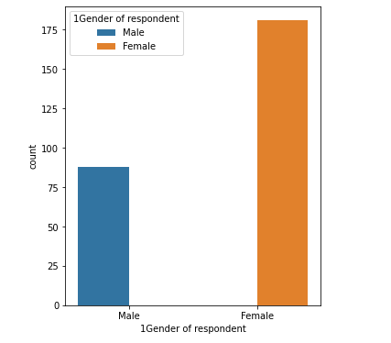
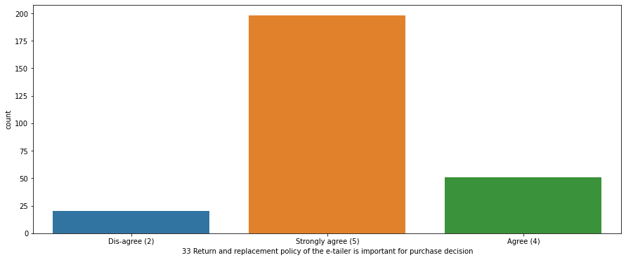
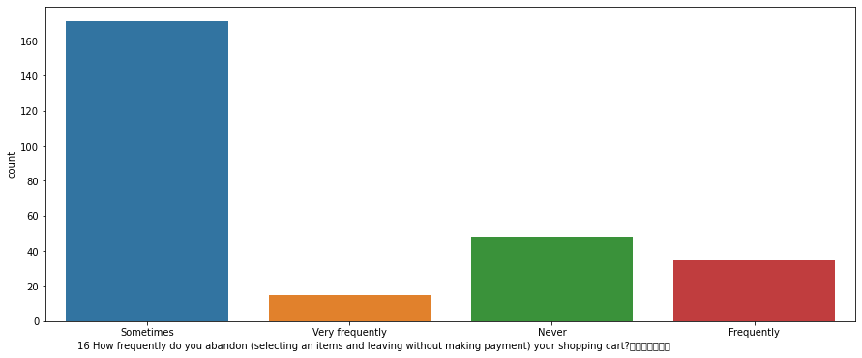
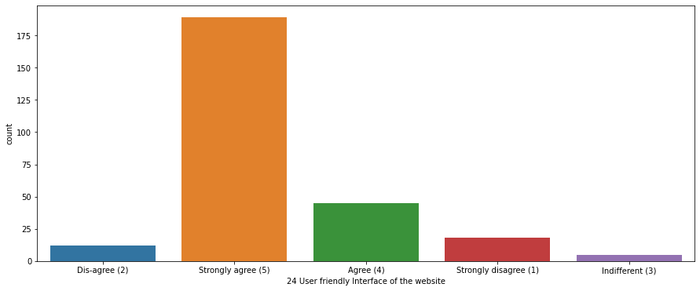
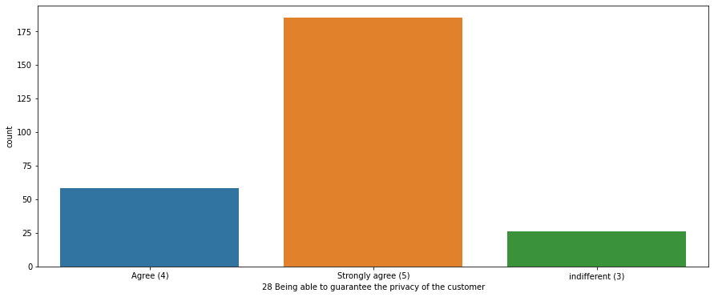
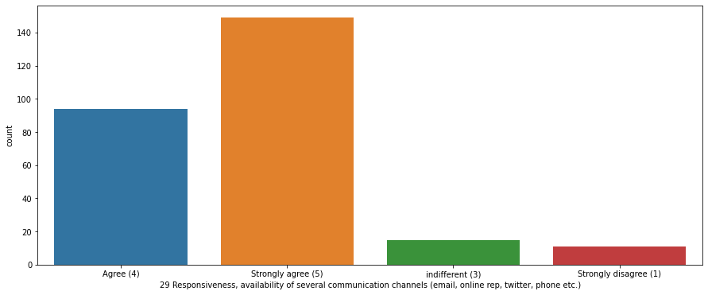
Visualizations done during EDA

Slide 6
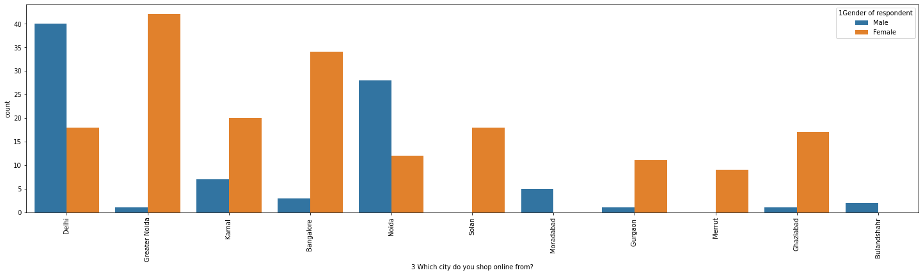
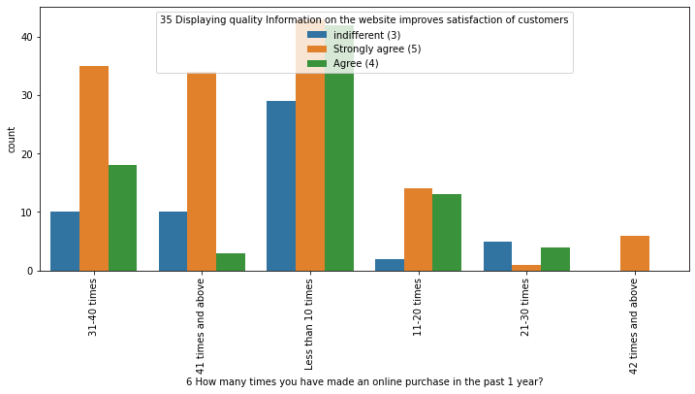
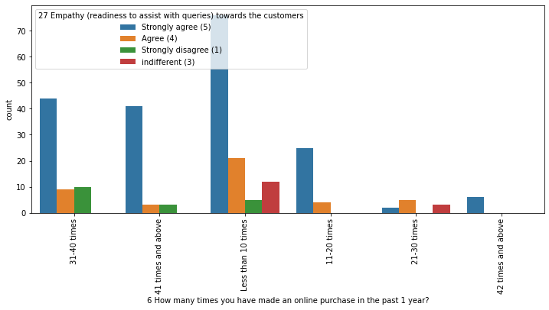
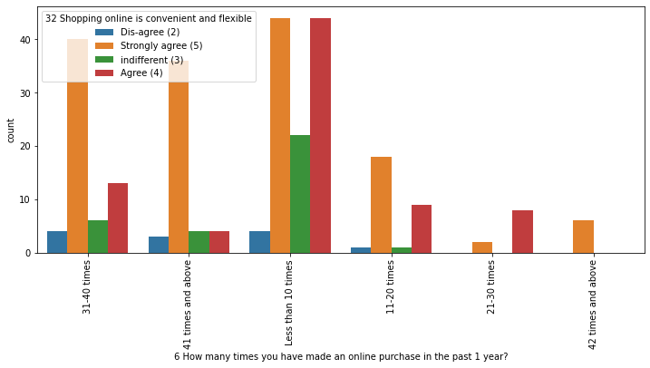
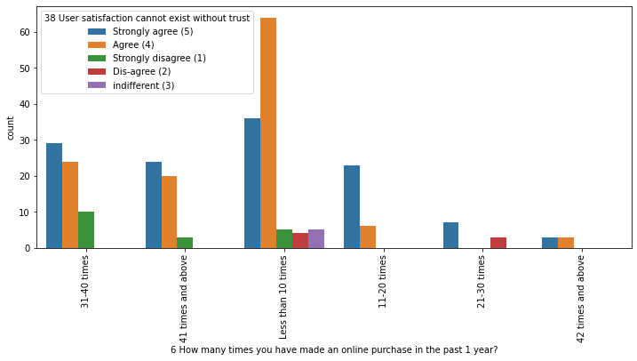
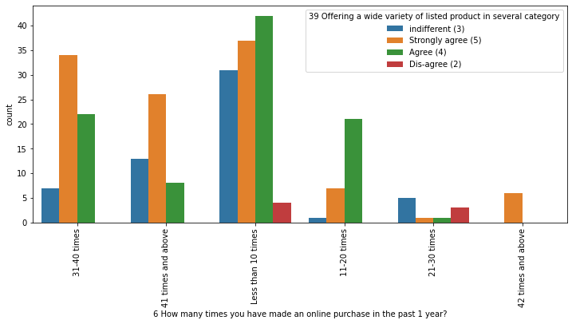

Slide 7
Important observation from above
We notice that Out of the total ,67% customer is female
87% customers agree with user friendly website interface.The online stores should invest heavily in creating user friendly apps and websites,so that the customers do not have to work around much and the overall shopping experience is smooth
59% customers strongly agree with the convenient paying methods.The reluctance to make online payments is gradually reducing. The acceptance has been built by addressing the trust issue over time by giving customers an option to pay online or to pay Cash On Delivery (COD)
Being able to guarantee the privacy of the customer: This also got 69% strongly agree.Costomers are concerned about the unauthorized access to their data.Protecting user privacy will enable stores to drive more revenue and gain more customers
Responsiveness, availability of several communication channels (email, online rep, twitter, phone etc.): 90% customers agreed to it. In case one channel is not available, customers can reach out to multiple channels which again is an important factor.Being able to communicate easily can make the difference in both their shopping experience as well as fulfill business goals of online store.
90% customers agree that return and replacement policy helps them making purchase decision. It is evident from the fact that people cannot actually try & touch the products ,they are purchasing before it reaches home and they would want to return or replace in case of dissatisfaction. Online shopping websites should make strategies around easy return and replacement policy if they want to retain their customers

Slide 8
Displaying quality Information on the website improves satisfaction of customers:80% customer agreed to it.It means displaying quality information have a significant association with customer satisfaction, and repurchase intentions.
85% customers agree that customer satisfaction cannot be built without trust. We see that,user with lack of trust have shpped less number of time.It means,trust is an area where online shopping still lags as several instances have been reported of customers being duped on receiving products that did not match the description claimed or turned out to be knock-offs.So, it is important for companies to learn how to manage consumers' trust
It can be seen clearly that all customers irrespective of the purchase count strongly agree with the empathy which means empathy is very important for customer satisfaction and hence retention. The reason is insecurity amongst the customers. If they have a provision of a helpline number associated with the website, that sense of insecurity vanishes and the customer can trust the website more. A 24X7 support is a must for these online retail stores.
Offering a wide variety of listed product in several category:Customers having purchase frequency of more than 30 times strongly agree to it.It means product variety increases consumers' likelihood of finding a good match with their preferences
Maximum customers agree with online shopping being flexible,irrespective of purchase count as it provides freedom to shop without the influence or pressure from sales staff often encountered in offline stores.
amazon & flipkart are liked by most number of people ,in terms of online shopping

Slide 9
CONCLUSION
Customer retention doesn't improve overnight. Customer retention is fickle when customer service is lacking. Few ways to improve customer retention can be as follows:
Easily navigable :
90% cusotmers agreed that the website should be easily navigable. Website navigation is a key to the success of any e-commerce website. It should be clean, clear and user-friendly. Online store should create easy-to-use navigation on website to make sure that ,customers don’t get confused while surfing the site.
User-friendly websites:
87% customers agree with user friendly website interface.The online stores should invest heavily in creating user friendly apps and websites,so that the customers do not have to work around much and the overall shopping experience is smooth,& shoppers get what they want faster and without running into unnecessary complexity that can clog up the path to purchase. It should focus on the user experience by providing shopping categories, filters, and comparison capabilities. User-friendliness requires that your website works on all browsers and devices

Slide 10
Improve return & refund policy:
Return policies are an essential feature of any ecommerce website .90% customers agree that return and replacement policy helps them making purchase decision. It is evident from the fact that people cannot actually try & touch the products ,they are purchasing before it reaches home and they would want to return or replace in case of dissatisfaction. Online shopping websites should make strategies around easy return and replacement policy if they want to retain their customers. This is another trust-building feature of online selling. ,which reassures buyers that if they are unhappy or just need a different size, the brand is there for them.
Privacy Policy:
Being able to guarantee the privacy of the customer:92% Customer agreed to this.Costomers are concerned about the unauthorized access to their data. Building trust with the customers is crucial for any e-commerce website. An E-commerce privacy policy statement makes business more transparent and trustworthy. Through this, online store can ease customer concerns regarding how you collect, manage, and use data from site visitors.
Displaying quality Information on the website :
90% customers agrees all relevant information on listed products must be stated clearly.Content is one of the crucial challenges for any e-commerce website. it’s simply not enough to just list a product name and image on a product page and expect the orders to roll in.Compiling a compelling array of product data, whether that’s dimensions, MPNs or spec sheets can all help to convert customers better.

